Slide 1
THE EFFECT OF A PRACTICE-BASED VERSUS THEORETICAL-BASED PEDAGOGICAL APPROACH ON JAZZ IMPROVISATION AND PERFORMANCE ACHIEVEMENT IN HIGH SCHOOL MUSICIANS
Glen A. Brumbach
Notes:
I wanted to arrange the room as a jazz club would be after all you are attending a peformance this morning. Set list – improvisation. Evolution of an artist as researcher.

Slide 2
What distinguishes jazz from other types of music?
Three Unique Criteria (Suber, 1976)
Improvisation (spontaneous composition)
Sense of moving time (swing style)
Individuality of expression (the ability to make and establish your own personal sound)
Core Activity - Improvisation (Prouty, 2012)
Jazz is Democratic (Berger, 2016; Marsalis, 1998).
Notes:
What distinguises jazz as a unique form of music and art.
Democratic as well a prepresentative of our country – all differen ethnic groups combingin.

Slide 3
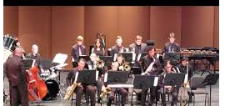
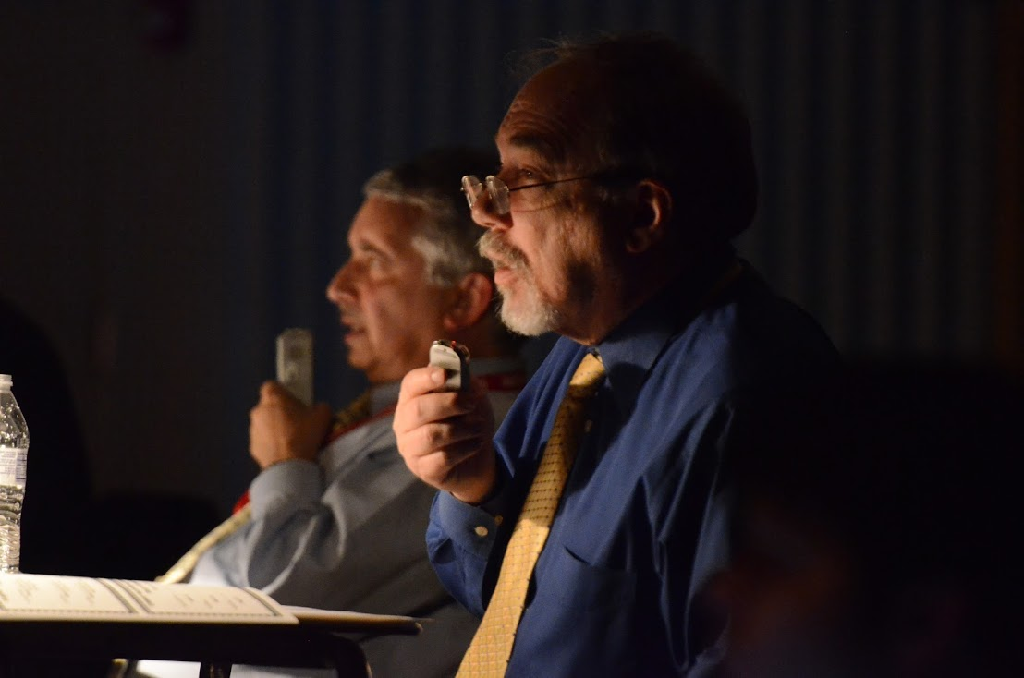
The Problem
Notes:
Each year hundreds of high school jazz ensembles participate in jazz festivals and adjudications (Ellis, 2007).
1. A typical scenario encountered at these festivals is as follows: The jazz band director counts off “ah one… ah three … ah one, two, three, four“, and the band begins a 12-bar blues tune that has the audience nodding their heads and tapping their toes to the beat. The band increases in intensity and volume as progresses, then a young tenor saxophone player nervously stands up and performs an improvised solo consisting of a litany of diatonic sequences and arpeggios based on the notes contained in the blues scale. The solo sounds more like an excerpt out of Herbert Clarke’s technical studies for cornet method rather than an inspired spontaneous composition. Parents from the school loudly applaud the soloist perhaps more out of appreciation of the soloists’ effort and school affiliation rather than any meaningful personal expression experienced.

Slide 4
The Problem
Teachers ill prepared (Balfour, 1988; Jones, 2005; Rummel, 2010)
Jazz Education in Colleges and Universities
Jazz not prioritized when hiring (Baker, 1981)
Jazz education training - experience as members of jazz ensembles (Treinen, 2011)
Polished Ensembles – little opportunity for creativity – (Warner, 2014)
Newer Jazz artists not original (Golson & Merod, 1998; Sandke, 2010)
Notes:
1The Lydian Chromatic Concept of Tonal Organization by George Russell .Hiring band directors
2 teachers perceptions o fnot being prepared to teach jazz and especially improvisation
Most jazz educaiton occurs in jazz ensembles among teachers
Results currently show polished ensembles will little opportunity for creatvity
Some newwer Jazz artists have been criticized for not having their individual sound and merely performing formulatic solos. Benny Golson refused to take a blindfold test on newer artists because he wouldn’t be able to tell the differnce.

Slide 5
Historically Authentic Jazz Learning Environments Ethnographic studies (Berliner, 1994: Goodrich, 2005; Monson, 1996; Renick, 2012)
Listening
01
Mentors?Apprenticeship
02
Culture/"Learning the Lingo"
03
Notes:
There wer no schools on how to play jazzRadio Listening to recordings is cited by many jazz scholars and artists as how they learned
Mentors – some to look up to attributed to Louis Armstrong – King Oliver, Buddy Rich and many other artists
A famous apprenticeship relations ship is Dizzy Gillespie influencing Jon Faddis as well as Artutor Sandoval.

Slide 6
Jazz Pedagogical Methodology
Theoretical-based Approach (TBA)
Practice-based Approach (PBA)
Technical/theoretical application for solos such as scales, chords repeated rhythmic patterns
Rehearsal techniques similar to large group ensembles such as concert band
Listening to recordings
Use of transcriptions
Listening to mentors
Interaction with jazz professionals
Use of authentic vocabulary and terminology
Notes:
What research has been done on jazz improvisation and performance achievement?

Slide 7
Purpose Statement
The purpose of this study was to investigate the impact of two methods of jazz instruction—theoretical-based and practice-based—on the performance and improvisation achievement of high school jazz musicians. Secondary purposes were to investigate (a) what instructional activities students in a jazz ensemble setting find useful in developing their performance and creative jazz improvisation skills; (b) how instruction in a jazz ensemble setting affects students’ perceptions and attitudes towards cultural diversity in music; and (c) jazz band directors’ perceptions of the effectiveness of the two types of jazz instruction.

Slide 8
Research questions
Is there a relationship between the jazz pedagogical approach selected and high school jazz musicians’ jazz improvisation improvement?
Is there a relationship between the jazz pedagogical approach selected and a high school jazz ensemble’s performance improvement?
Is there a relationship between the jazz pedagogical approach selected and the usefulness of jazz improvisation and performance activities among high school jazz musicians?
Is there a relationship between the jazz pedagogical approach selected and high school jazz musicians’ attitudes towards musical and racial-ethnic attributes of jazz?
What are the attitudes of jazz ensemble directors toward the practice-based approach as compared to the theoretical-based approach?

Slide 9
Jazz pedagogies and effectiveness
Ethnographic studies (Berliner, 1994: Goodrich, 2005; Monson, 1996; Renick, 2012)
Bash (1983) – Technical vs. aural approach
Aural vs. Visual approach effectiveness (Ciorba, 2006; Flack, 2004; Heil, 2005; Laughlin, 2001; Madura, 1996; May, 2003; Watson 2008)
Predictor Studies
Ecological validity compromised
Historical Component

Slide 10
Jazz improvisation and Performance Measurement
Improvisation Achievement (May, 2003; Smith, 2009; Watson 2008; Wesolowski, 2013)
Performance Skills
Creative development
5–14 criteria
Ensemble Performance achievement (Wesolowski, 2016)
Blend/Balance
Time/feel
Idiomatic nuance
Expression
Notes:
Technical
Facility
Rhythmic Feel, Sense of Time
Melodic, Rhythmic Development
Style
Harmonic Awareness
Expressiveness
Creativity
Interaction and communication

Slide 11
Method
Notes:
I decided to conduct an experiment with the theoretical=based approach as the control treatment and the practice-based approach as the experiemtnal treatment.

Slide 12
Sample
Southeast Region of Mid-Atlantic State | Theoretical –based Group | Practice-based group | Total
Ensembles | 5 | 5 | 10
Soloists | 13 | 21 | 34
Participants | 102 | 89 | 191
Notes:
A cluster sampel was chosen from a southeastregional area of a Mid-Atlantic state I was very familiar with. Attrition todue t various factors hadus arrive at the final numbers you see before you.

Slide 13
Procedure
Music
Time period
Measurement Instruments
Jazz Improvisation Performance Achievement (JIPM)
Jazz Ensemble Performance Measure (JEPM)
Student Jazz Attitude/Background Survey (SJABS)
Director Interview
Adjudicators
Training
Interjudge Reliability > .98 (n =8)
Notes:
Music – rom Essentially Ellington - Stay On It Tadd Cameron/Dizzy Gillespie – recorded by Basie 1946. Form of the piece based on Rhythm changes – ensemble head – solo choruses. Tag ending. Pretest – posttest recordings
Had judges do dfferent aspects.
Technical facility, Rhytmic feel sense of time, harmonic awarness creativity style expressiveness interaction
Blance/tone/blend, interp. Intonation, rhythm, precision, improv.
Pilot test Intraclass correlation coefficient – greater than .98

Slide 14
Treatment Schedule
TBA
PBA
Pretest
Rehearse as you would in concert band
Supply soloists with appropriate scales and arpeggios.
Posttest
Survey
Pretest
Access Tuttiplayer for personal use
Listen to recordings
Learn solo transcriptions
Listen to Ellington’s Cottontail
Posttest
Survey

Slide 15
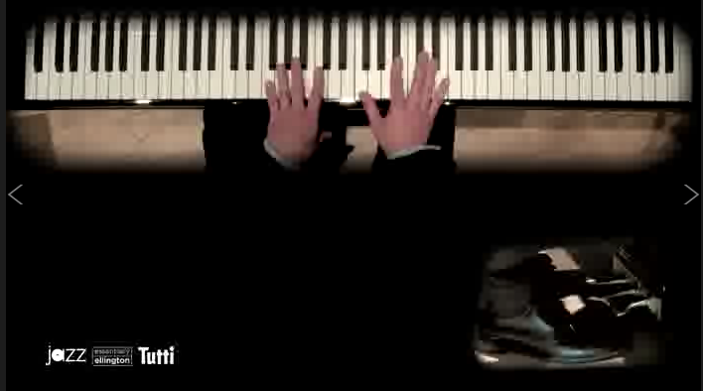
Mentoring and Apprenticeship

Slide 16
Results
Notes:
Cronbach’s alpha was used to determine the internal reliability of the instruments used to measure jazz performance achievement, JEPA and jazz improvisation achievement, JIPM. The Cronbach alpha coefficient for the JEPA was .98. The Cronbach alpha coefficient for the JIPM was also .98 suggesting a strong internal consistency for both measures. The testing of reliability of the SJABS produced a reasonably strong coefficient of .63 with two items being reverse order suggesting a weaker yet reliable internal consistency.
Interjudge reliability was calculated using an intraclass correlation coefficient (ICC). resulted in strong agreement among all three judges with a composite score coefficient of .93 in the JEPA and a composite score coefficient of .87 in the JIPM

Slide 17
Jazz Improvisation Achievement
Between subjects repeated measure ANOVA – [F (1,32) = 5.22, p = .029, eta²=.144]
Paired Sample t test - t (32) = -2.88, p = .007
Notes:
Results indicated a statistically significant finding for pedagogical approach [F (132) = 5.22, p = .029, eta²=.144] as an effect on improvisation achievement. A paired sample t test compared mean gain scores (posttest score means minus pretest score means) by pedagogical approach and showed a statistically significant difference between the theoretical-based approach (TBA) gain (M= 5.36, SD=1.18) and the practice-based approach (PBA) gain (M= 9.86, SD=.99) conditions; t (32) = -2.88, p = .007. Effect size was calculated at .144 which means that 14% of the improvement in improvisation achievement can be attributed to the PBA

Slide 18
Student Attitudes and Perceptions Relating to the Approaches
How useful were the approaches?
Question | Theoretical-based Approach |  | Practice-based Approach |  | Sig | Effect
 | M | SD | M | SD | P | d
Improvisation skill improved | 3.31 | .75 | 3.71 | .64 | .10
Performance skill improved | 3.79 | .87 | 4.12 | .77 | .001 | .51
Note: Questions M calculated from Likert scale: 1 Strongly disagree – 5 Strongly agree *p< .05. **p<.01 ***p<.001.
Notes:
Ttest were used to compare the responses from the approach groups pertaining to usefulness o the approaches. Results indicated no significant difference between the approahcs’ soloist on how useful the approach was Btoh groups felt they improved with the approach. For performance while both froups felt they improved through their perofrmance the practice based group felt significantly stronger that the paproahc improved their performance.

Slide 19
Individuality of Expression
Question | Theoretical-based Approach (n=102) |  | Practice-based Approach (n=89) |  |  | Sig | Effect
 | M | SD | M |  | SD | P | d
Unique personal sound | 2.96 | 0.89 | 3.27 | 0.94 |  | .020* | .34
Increased ability to express | 3.17 | 1.09 | 3.54 | 0.93 |  | .012* | .36
Personality in the music. | 4.07 | 0.80 | 4.35 | 0.81 |  | .018* | .35
Scales/arpeggios vs. personal expression | 2.36 | 0.99 | 2.37 | 1.04 |  | .957
Note: Questions M calculated from Likert scale: 1 Strongly disagree – 5 Strongly agree *p< .05. **p<.01.
Notes:
A paired sample t test was peformed to compare responses to questions pertaining to indidivuality of expression. The categories of establishing indivdiual unique personal sound, personal expression and importance of personality oin music solos was found to be sifnigicantly stronger in the PBA group as compared to the TBA group. No significant difference was found between the groups regarding recogniition of personal expression.

Slide 20
Racial and Ethnic Contributions
Question | Theoretical-based Approach (n=102) |  | Practice-based Approach (n=89) |  |  | Sig | Effect
 | M | SD | M |  | SD | P | d
Respect of contributions | 2.82 | 1.10 | 3.15 | 1.13 |  | .048* | .30
Decreased appreciation | 1.72 | 1.08 | 1.57 | 1.20 |  | .388
Enhanced understanding o | 2.67 | 1.16 | 2.83 | 0.99 |  | .414
Jazz separate from cultural | 2.52 | 1.22 | 2.38 | 1.20 |  | .415
Explore historical cultural context of music | 3.23 | 1.12 | 3.48 | 1.22 |  | .131
More likely to listen to jazz | 3.25 | 1.19 | 3.78 | 1.00 |  | .001** | .48
More likely to improvise | 1.79 | 0.49 | 1.70 | 0.49 |  | .172
Note: Questions M calculated from Likert scale: 1 Strongly disagree – 5 Strongly agree, except More likely to improvise: 1 more likely – 3 less likely *p< .05. **p<.01.
Notes:
Respect of the contributions of racial and ethnic groups was significantly stronger in the practice based group however there were no differenc in the attitudesof PBA participants indidcated as a result of the study they were significantly more likely to listen to jazz outside of school .

Slide 21
Director Quotes
“You know I’ve played recordings for them but anything where you can get the live band playing is much more arresting for the viewer…. It allows them to focus on what they’re doing rather than showing a video of the whole band where they say, ‘I wonder what kind of club that is’ or ‘there’s a waitress going by’ you know there’s so many things so where there’s something that’s so focused, it greater enhances their ability to learn from it.”
“I can tell them all kinds of stuff but it’s not like getting it [from] watching these guys playing….there were a number of times through out the course of the exercise they would say ‘Well I noticed on the app they would do this but it’s not necessarily written on the part, should I?’ and I would say ‘Whatever you hear those guys do, do it!’ They’re certainly not gonna get it from me. They’re picking up the nuance of what these guys actually do, it’s great.”
Notes:
The first quote pertains to the focus provided by the tutti player app as compared just to playing videos off of youtube The sedon quote is an example of how students were empowered to initiate their own comprehension and application of styles and techniques observed throught he tuttiplyaer app much like spending time with a mentor would do.

Slide 22
Conclusions and Discussion
The PBA had a significantly stronger effect on jazz improvisation achievement than the TBA.
Students using the PBA indicated a stronger sense of improvement in jazz ensemble performance than those using the TBA.
Practice-based participants indicated stronger ability to express their individuality through jazz improvisation.
Participants using the PBA indicated a stronger desire to listen to jazz outside school following the treatment.
Notes:
The results of the pretest and posttest gains in both the theoretical-based approach (TBA) and the practice-based approach participants (PBA) agree with previous studies that improvisation can be taught (Humphreys, May, & Nelson, 1992, Madura, 1996). The results of the effectiveness of the practice-based approach and theoretical-based approach agree with previous studies’ findings that instruction in jazz improvisation is effective for jazz improvisation improvement (Bash, 1983; Heil, 2005; Laughlin, 2001; Watson, 2008). The significant improvement shown by the practice-based versus the theoretical based approach also aligns with Bash’s findings that non-technical methods significantly improved students’ improvisation achievement compared to the specifically technical methods. The results of this study also concur with a growing body of literature (Bash, 1983; Ciorba, 2006; Davison, 2006; Flack, 2004: Heil, 2005; Laughlin, 2001; Madura, 1996; May, 2003; Watson, 2008) indicating the importance of aural skills when engaged in jazz improvisation activities. This study did not explore whether the aural skills were a predictor of jazz improvisation as was found in previous studies (Madura, 1996; May, 2003). Jazz Perrmance achievment agrees with modeling by Davison, Hewitt

Slide 23
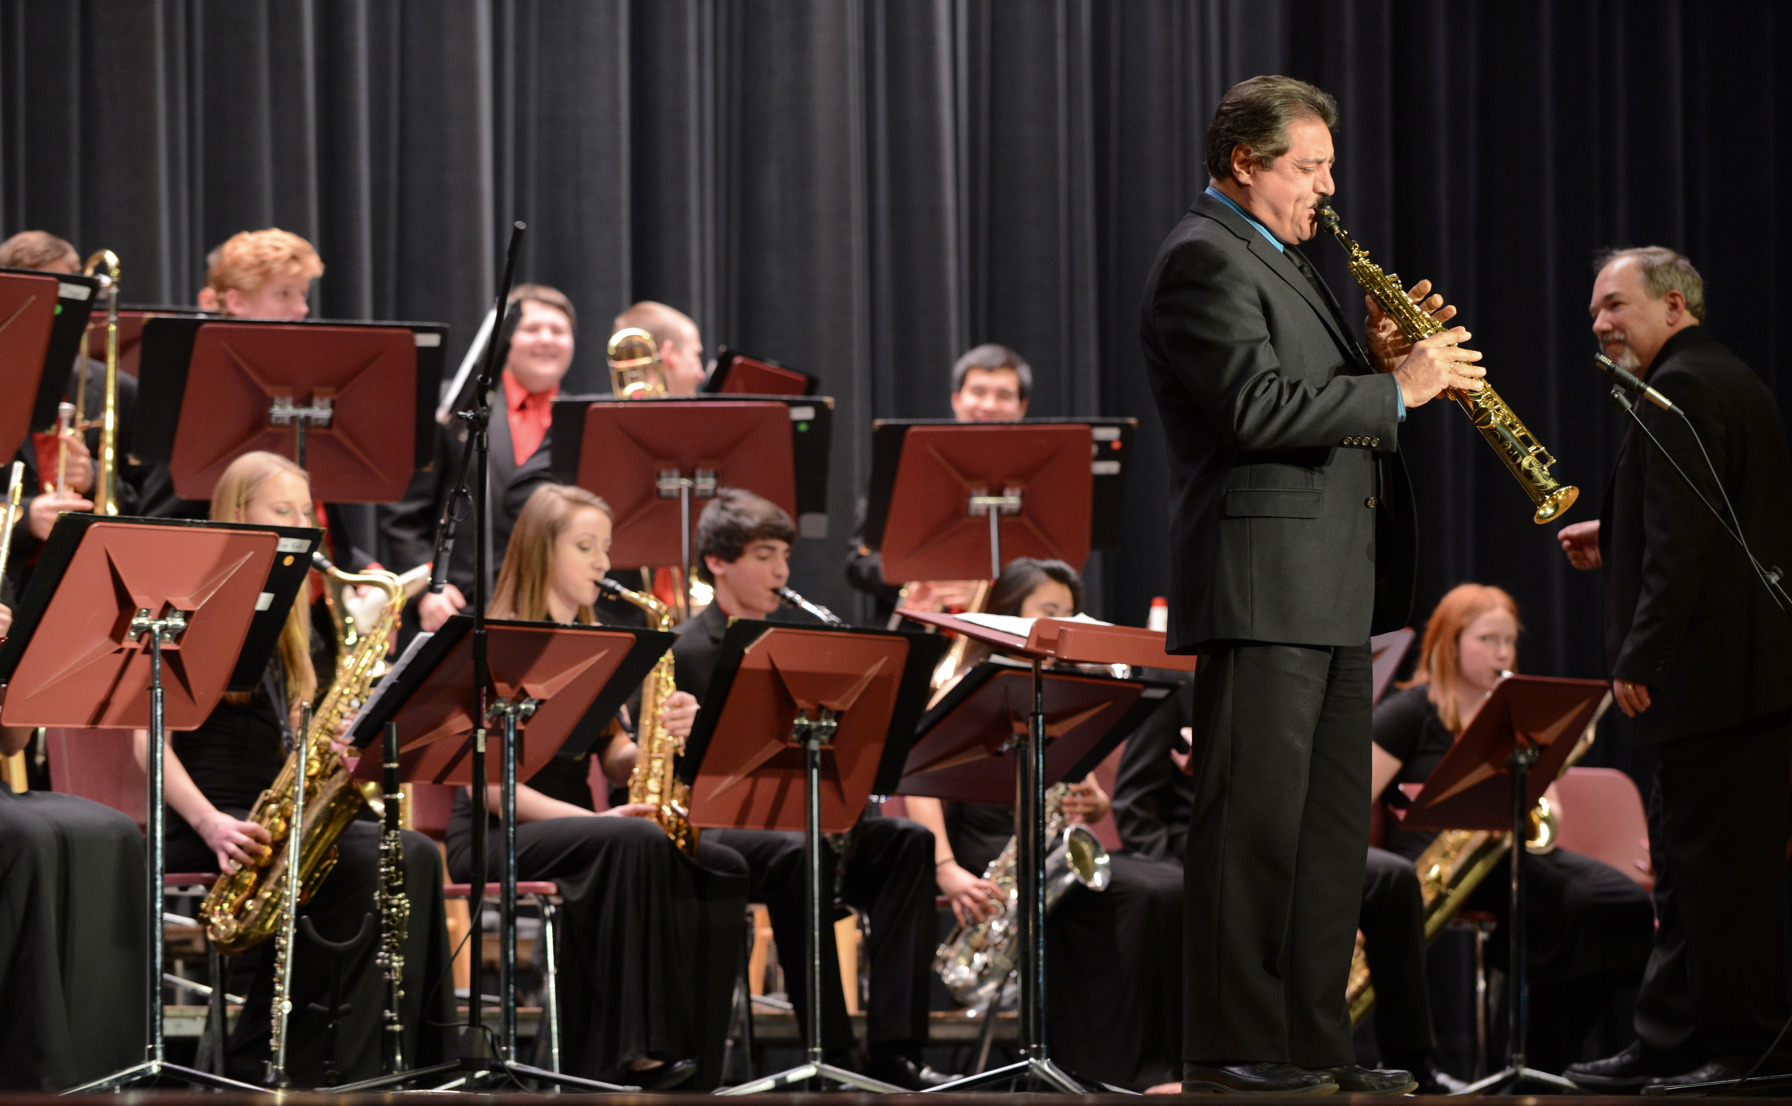
Questions?
Glen A Brumbach
gbrumbac@umd.edu

Slide 24
